Slide 1
TRANS & QUEER MUSIC RESISTANCE
Finding Our Rhythm
Created by the Youth Organizing Team

Slide 2
Introductions
Type in the chat!
Name
Pronouns
Grade or school
Who is your favorite LGBTQ+ singer, rapper, or performer right now?

Slide 3
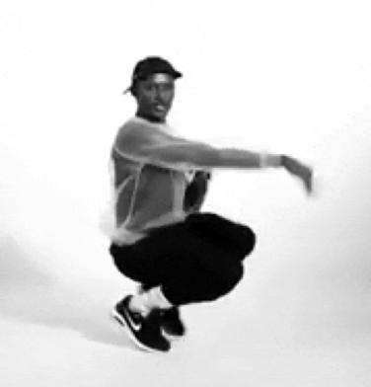
Agenda
Welcome & Community Agreements
Wellness Tip: Finding Rhythm
LGBTQ+ Identity & Resistance Music
Closing & Announcements

Slide 4
Today’s Goals
Here’s what we hope you take away from this workshop!
Find and draw energy from rhythm all around us
Learn about the contributions and influence of trans and queer folks in music & performance
Leave with something you can practice & explore

Slide 5
Sample Community Agreements
Be as present as you can.
1) Mute audio
2) Try on video
3) Use the chat box
“Vegas Rule”
What’s said here stays here; what’s learned here leaves here.
“Right to Pass”
Community Garden
→Chat it!
Intent vs. Impact
Use content
warnings.
Understand informed consent.

Slide 6
Wellness Tip: Find Your Rhythm
Listening to music is a powerful way to change your mood!
Music is a universal language and expresses emotions in ways that words cannot.
Notes:
Facilitator Script: Let’s look at some ways music shows up in our everyday lives and how our bodies have rhythms of their own.

Slide 7
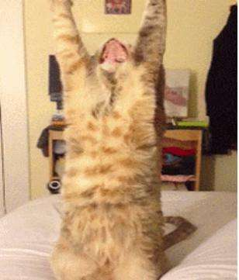
Hand Stretches
Stretching movements prepare our bodies and minds to listen.
1. Stick out both arms, palms facing down. Then, squeeze your hands in a fist, hold, and release.
2. Try this with your palms facing up. Squeeze your hands in a fist, hold, and release.

Slide 8
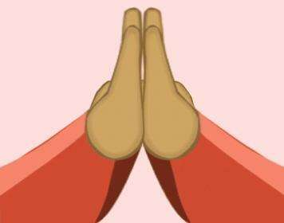
Arms Stretches
Place your hands in a prayer position and keep your elbows up and even.
1. Point your hands up and hold.
2. Point your hands outward and hold.
3. Point your hands inward and hold.

Slide 9
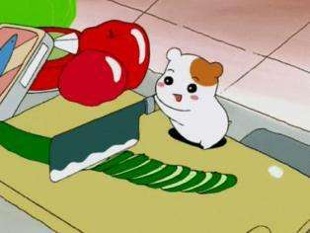
Rhythm Section
All around us is noise, but if you pay close attention you might find some beats and rhythms!
What’s a beat? Any noise, like a drum strike, clapping, snapping, teeth brushing, chopping food, etc.
What’s rhythm? A pattern of notes!
What is one rhythm we all share?

Slide 10
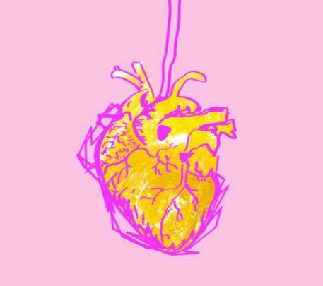
Universal Rhythm
The heartbeat is one of the universal rhythms we share.
If you listen close you will hear:
Lub-Dub, Lub-Dub, Lub-Dub, Lub-Dub
Try to find your heart’s rhythm and time it with your breath!

Slide 11
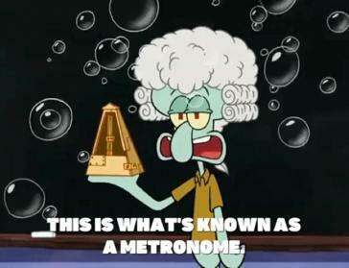
Rhythm Practice
Metronome: An instrument used to keep time in music. It makes a click for every note.
Count or snap out loud: 1 - 2 - 3 - 4 , 1- 2 - 3 - 4

Slide 12
Rhythm Practice: Strike on the “X”
Set your metronome to 90. Practice clapping or counting out loud on the “X”!
1 - 2 - 3 - 4 1 - 2 - 3 - 4
To Start: X - 2 - 3 - 4 - X - 2 - 3 - 4
Now Try: X - X - 3 - 4 - X - X - 3 - 4
Now Try: X - X - X - X - X - X - X - X
Notes:
Facilitator Note: These sites have free metronomes to use for this activity:
https://www.imusic-school.com/en/tools/online-metronome/
http://a.bestmetronome.com/
https://www.musicca.com/metronome

Slide 13
Music = Art
Music is a powerful tool that can directly affect our emotions or state of mind!
Many rhythms out in the world are direct ties to ancestral cultures that have survived time itself!
Music is a tool and product of resistance and can be used to send a message so...
Tune in and Listen Closely to the sounds around you and maybe you will find the rhythms in life!

Slide 14
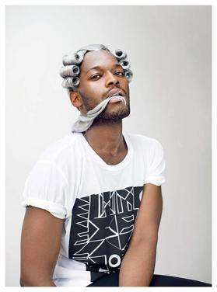
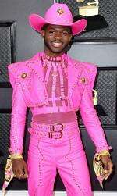
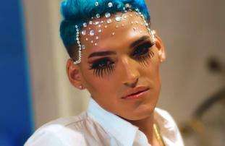
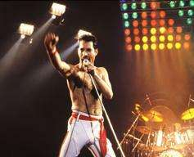
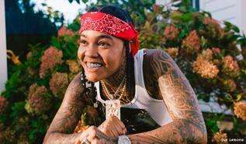
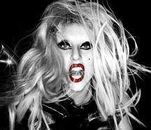
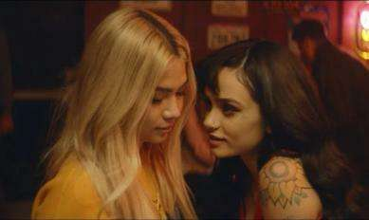
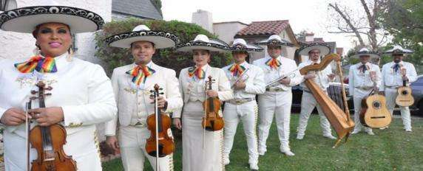
LGBTQ+ Identity & Resistance Through Music
“Music is the tool to express life – and all that makes a difference.” – Herbie Hancock
Notes:
Photo: https://www.highsnobiety.com/p/hayley-kiyoko-kehlani-what-i-need-video/
Photo: https://queerspacemagazine.com/who-will-save-queer-hip-hop/zebrakatz/
Photo: https://www.rollingstone.com/music/music-latin/kevin-fret-gay-trap-star-murdered-puerto-rico-777229/
Photo: https://www.timeout.com/newyork/music/single-file-le-tigre
Photo: https://qvoicenews.com/2018/09/12/mariachi-arcoiris-de-los-angeles-the-worlds-first-queer-mariachi-band/
Photo: https://www.eonline.com/news/1120187/lil-nas-x-channels-buffy-thriller-and-more-in-new-rodeo-music-video
Quote: https://www.musicnotes.com/now/omg/50-inspirational-quotes-about-music/
Photo: https://www.out.com/music/2019/11/19/young-ma-first-lgbtq-rapper-cover-out-magazine

Slide 15
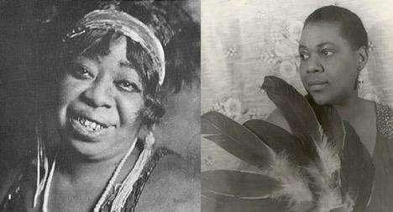
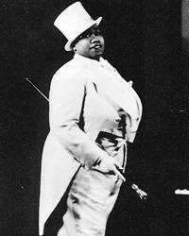
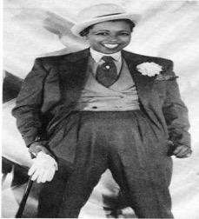
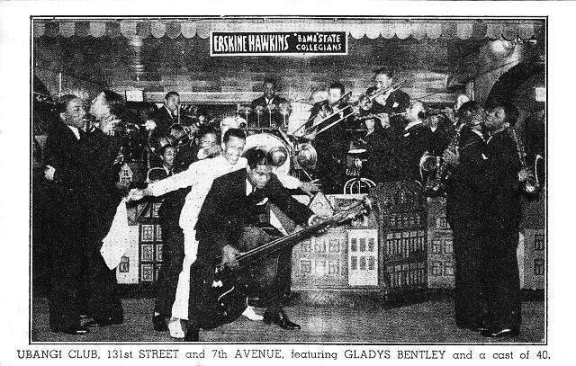
Harlem Renaissance "…surely as gay as it was black”
Notes:
Facilitator Note: Play this video - https://www.youtube.com/watch?v=i2u6JO4Q5g0.
Facilitator Script: The HR was historically known for its explosive impact on black literature, culture, music and fashion. What’s not said is that a lot of that culture was created and led by queer artists and writers. In particular there was a significant presence of lesbian and bisexual women leading the way in blues and jazz music and were often responsible for the night life of the Harlem club scene.
Additional information to share:
https://www.sun-sentinel.com/entertainment/events/fl-xpm-2010-05-10-fl-gay-harlem-renaissance-exhibit-20100506-story.html
https://www.advocate.com/women/2017/3/16/women-who-paved-way-blues-singer-gladys-bentley
http://www.thelgbtsentinel.com/queer-blues-queens-early-20th-century/
https://www.wussymag.com/all/2016/2/18/yesterqueers-queers-of-the-harlem-renaissance

Slide 16
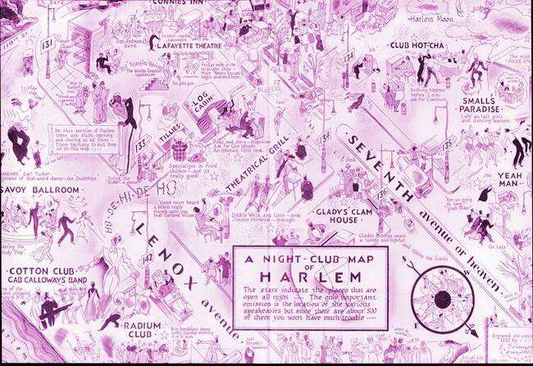
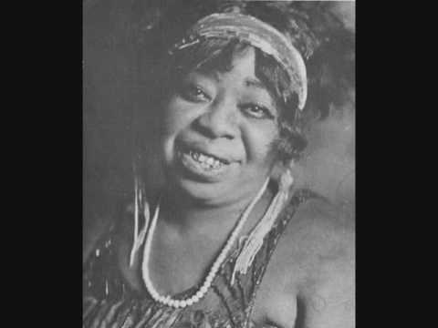
Ma Rainey’s ‘Prove It On Me Blues’
When I last night, Had a bad big fight
Everything seemed to go on wrong
I looked up, to my surprise
The gal I was with was gone.
Where she went, I don't know
I mean to follow everywhere she goes;
Folks say I'm crooked. I didn't know where she took it
I want the whole world to know.
They say I do it, ain't nobody caught me
Sure got to prove it on me;
Went out last night with a crowd of my friends,
They must've been women, 'cause I don't like no men.
It's true I wear a collar and a tie,
Makes the wind blow all the while
Don't you say I do it, ain't nobody caught me
You sure got to prove it on me.
Say I do it, ain't nobody caught me…
Notes:
Additional information to share:
https://www.billboard.com/articles/news/pride/7824784/ma-rainey-lesbian-lyrics
https://www.youtube.com/watch?v=i2u6JO4Q5g0
https://taggmagazine.com/queer-black-history-ma-rainey/
https://www.queerportraits.com/bio/rainey
https://www.collectorsweekly.com/articles/singing-the-lesbian-blues-in-1920s-harlem/

Slide 17
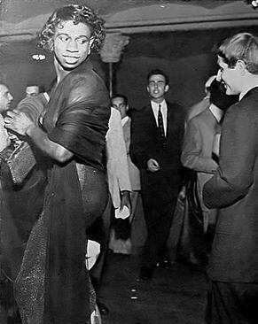
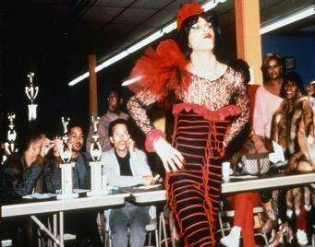
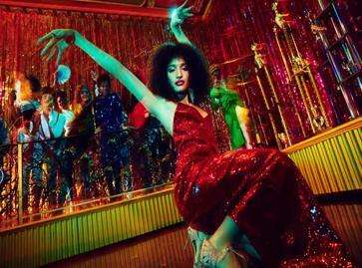
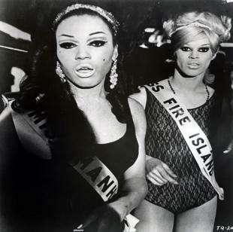
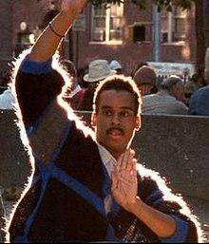
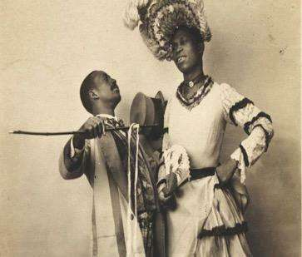
House is a Home: Drag & Ballroom Culture
“I have a right to show my color, darling,” LaBeija shoots back. “I am beautiful and I know I’m beautiful.”
Notes:
Facilitator Script: Ball Culture been around since the 1800s at least. In the 1960s it was predominantly led by white audiences. That evolved over time thanks to people like Crystal Labeija (on next slide).
Additional information to share:
https://www.theguardian.com/tv-and-radio/2019/mar/21/pose-review-ryan-murphy-show-voguing-underground-ballroom-new-york
https://www.thenation.com/article/society/drag-queen-slave-ball/
Photo: https://www.washingtonblade.com/2019/04/11/paris-is-burning-will-return-to-theaters-for-pride-month/

Slide 18
Crystal LaBeija (1960s)
Notes:
Facilitator note: Play video - https://www.youtube.com/watch?v=pKGKcsdkgto&t=29s
Additional information to share:
https://www.them.us/story/how-crystal-labeija-reinvented-ball-culture

Slide 19
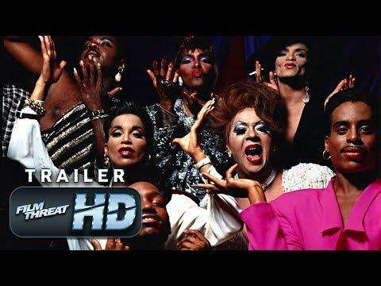
Paris is Burning (1990)
Notes:
Facilitator Note: Play this trailer for Paris is Burning: https://www.youtube.com/watch?v=o47CwiJLpes
Full documentary can be watched her: https://www.youtube.com/watch?v=xf6Cn2y2xEc

Slide 20
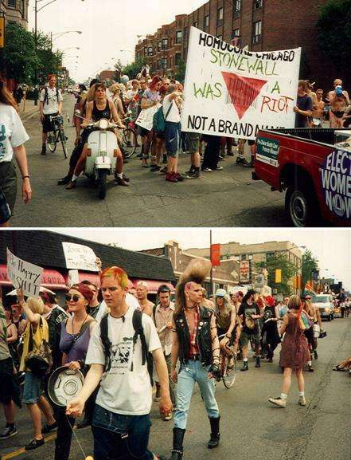
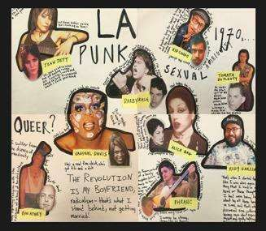
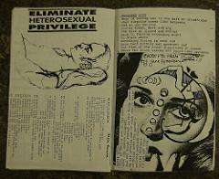
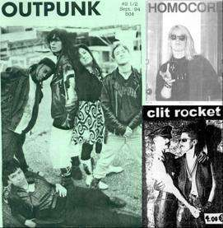
QueerCore & The Riot Grrrl Scene
Notes:
Facilitator Script: Queerness was a big part of punk rock as well! The Homocore Zine in the late 80s was a San Francisco zine that contributed to the Queercore movement, which fused elements of punk and hardcore counterculture with the queer culture. The fusion was a response to sexism and homophobia within the existing punk scene. Some bands: were G.L.O.S.S., Le Tigre/Bikini Kill, and Limp Wrist.
https://complicatingqueertheory.files.wordpress.com/2013/11/homocore2.jpg
https://one.usc.edu/archive-location/als-bar-0
http://gritandglamourla.com/main/vaginal-davis-1
https://haenfler.sites.grinnell.edu/subcultures-and-scenes/riot-grrrl-2/

Slide 21
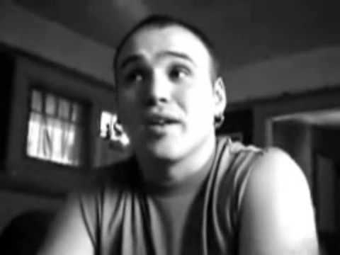
Limp Wrist
“I love hardcore boys, it's too good to be true
One on one or the whole damn crew
It's all exciting for us so let’s give it a whirl
I love hardcore boys cuz they make my toes curl”
Lyric excerpt from Limp Wrist’s song ‘I love hardcore boys’
Notes:
Facilitator Note: Play this video of Martin Sorrondeguy - https://www.youtube.com/watch?v=ZhDETXvi9yw

Slide 22
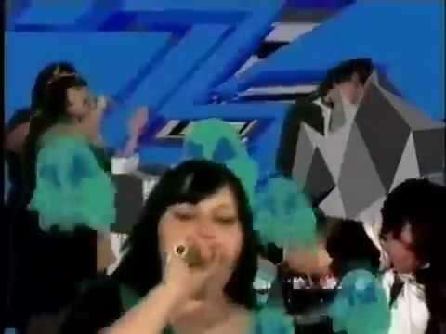
Gossip: Standing in the Way of Control
Your back's against the wall
There's no-one home to call
You're forgetting who you are
You can't stop crying
It's part not giving in
And part trusting your friends
You do it all again
And I'm not lying
Oh oh oh oh oh oh oh
Oh oh Oh oh oh oh oh oh oh
Standing in the way of control
You live your life
Survive the only way that you know
Notes:
Facilitator note: Play this video - https://www.youtube.com/watch?v=yn043ArR98M
Additional information to share:
https://www.theguardian.com/music/2019/jul/15/beth-ditto-how-we-made-gossip-standing-in-the-way-of-control-bible-belt

Slide 23
Group Discussion
Let’s unpack some of what we just learned!
What era/genre stood out to you and why?
What different issues were the artists speaking on?
How has the LGBTQ+ community used music & performance to define identity?

Slide 24
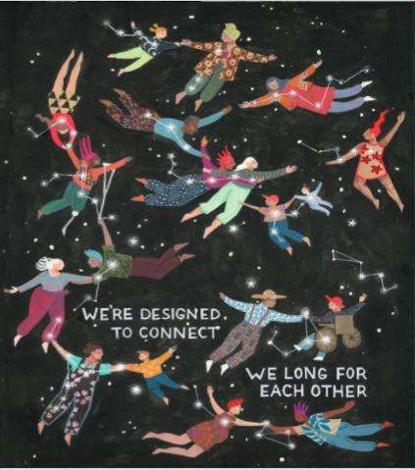
Closing & Announcements
Next meeting date and time
For LGBTQ+ stories, read Youth Voices
Click here to sign up for weekly GSA Network updates.

Slide 25
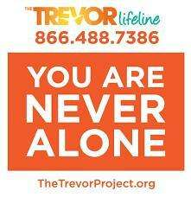
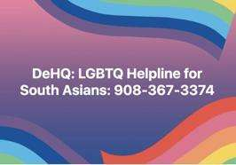
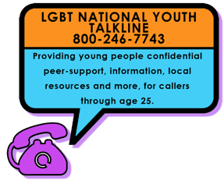
Get Immediate Support
English + Espanol

Slide 26
THANK YOU!

