Slide 1
HIV/AIDS Youth Awareness
Created by the Youth Organizing Team

Slide 2
Introductions
Introduce yourself in the chat!
Share your name, pronouns, school & city, and your favorite cartoon (show or movie) to watch.
Notes:
Tony Starts Screen sharing.

Slide 3
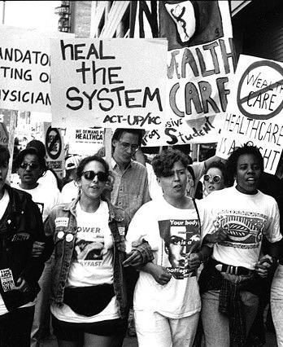
Agenda
Welcome, Housekeeping, & Agreements
Wellness Tip
HIV/AIDS Activism
Safeguards and Prevention
Announcements & Closing

Slide 4
Today’s Goals
Learn the history of the HIV/AIDS activist movement
Find community care and resources for youth living with HIV/AIDS or familiar with someone who is
Share wellness tips to practice self love during this time of being home

Slide 5
Sample Community Agreements
Be as present as you can.
1) Mute audio
2) Try on video
3) Use the chat box
“Vegas Rule”
What’s said here stays here; what’s learned here leaves here.
“Right to Pass”
Community Garden
→Chat it!
Intent vs. Impact
Use content
warnings.
Understand informed consent.

Slide 6
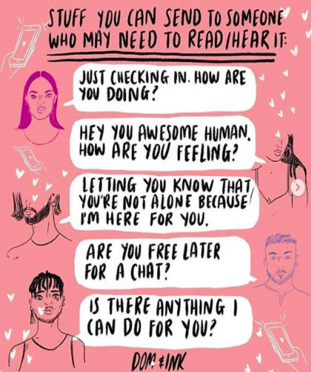
Wellness Tip: Checking In

Slide 7
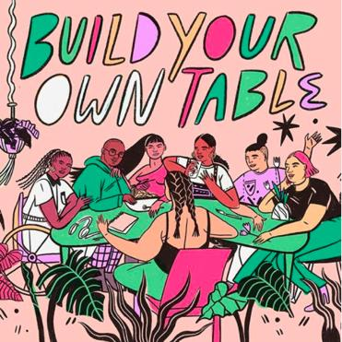
Wellness Tip: Finding Chosen Family
Where have YOU found your chosen family or community?
Notes:
Facilitator note: Play this video from Pose about chosen family before posing the discussion question: https://youtu.be/H_GEUt2WyF8.

Slide 8
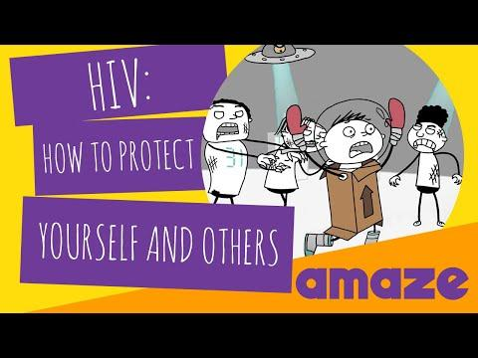
HIV/AIDS Awareness
What stigma have you read or heard about people living with HIV/AIDS?
Notes:
Facilitator note: Play this short educational video about HIV/AIDS before posing the discussion question: https://www.youtube.com/watch?v=xK-VPgmn-18.

Slide 9
HIV/AIDS Activism
“How to Survive a Plague” is a documentary about the HIV/AIDS epidemic in the ‘80s and ‘90s. It depicts the story of activists pushing back against the federal government's response to the epidemic.
Notes:
Facilitator note: Play the “How to Survive a Plague” trailer as an introduction to the long history of HIV/AIDS activism: https://www.youtube.com/watch?v=haEPLCA_H2Y.

Slide 10
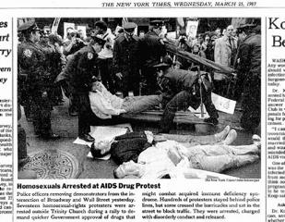
HIV/AIDS Activism
1982: The CDC establishes the term Acquired Immune Deficiency Syndrome (AIDS)
1987: ACT Up (the AIDS Coalition To Unleash Power) — a diverse, non-partisan group of individuals — united in anger and committed to direct action to end the AIDS crisis
1987: ACT Up stages its first protest on Wall Street, demanding that the Federal Drug Administration (FDA) release treatments for HIV
1988: ACT UP, joined by the national ACT NOW coalition, closes down the FDA outside of Washington, D.C.
Notes:
Sources:
https://www.ucsf.edu/news/2011/06/104134/thirty-years-aids-timeline-epidemic
https://actupny.com/contact/
https://actupny.org/documents/cron-88.html-
https://actupny.org/documents/cron-89.html

Slide 11
HIV/AIDS Youth Activism
In 1991, ACT UP's Youth Education Life Line (YELL) organized a sexual health education campaign, demanding the New York City Board of Education to vote in support of condom distribution to high school students on their campuses.

Slide 12
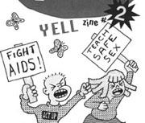
HIV/AIDS Youth Activism
1991: New York City Board of Education votes 4-3 to approve a plan to distribute condoms to high school students in the public schools
1991: YELL defeats an amendment to the condom distribution. Amendment would give parents the right to "opt-out" and bar their children from receiving condoms in school
1992: YELL protests at the New York City Board of Education to oppose Christian fundamentalists and promote HIV/AIDS education in New York City Public Schools
1995: YELL protests the Board of Education's elimination of condom demonstrations in the classroom and the failure of AIDS prevention education in the public schools
Notes:
Sources:
https://actupny.org/documents/cron-91.html
https://actupny.org/documents/cron-92.html
https://actupny.org/reports/timeline95-96.html

Slide 13
HIV/AIDS & Identity
Race: Black and Latinx people are disproportionately impacted by HIV (parallels the Black community being disproportionately affected by COVID-19).
Work discrimination and class impact contraction rates: Low income communities are at higher risk.
Gender: Women are at higher risk.
Notes:
Sources:
https://www.ucsf.edu/news/2011/06/104134/thirty-years-aids-timeline-epidemic
https://www.cdc.gov/hiv/group/poverty.html
https://actupny.org/documents/cron-88.html

Slide 14
Group Reflection
Notes:
Facilitator asks the following questions: How are folks feeling or sitting with after learning this information? Any initial reactions to this content?

Slide 15
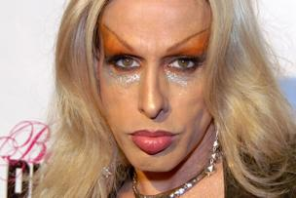
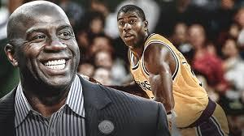
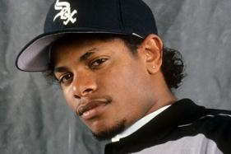
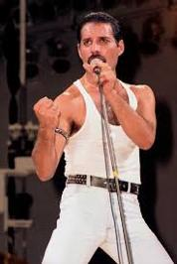
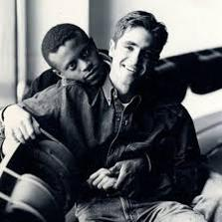
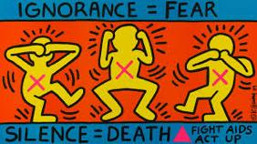
HIV/AIDS & Pop Culture
Notes:
Celebrities who live or lived with HIV/AIDS (from top left to top right, then bottom left to bottom right): Magic Johnson, Patricia Arquette, N.W.A.’s Easy-E, Freddie Mercury, Pedro Zamora, Image by the artist Keith Haring, Queer Eye’s Johnathan Van Ness.

Slide 16
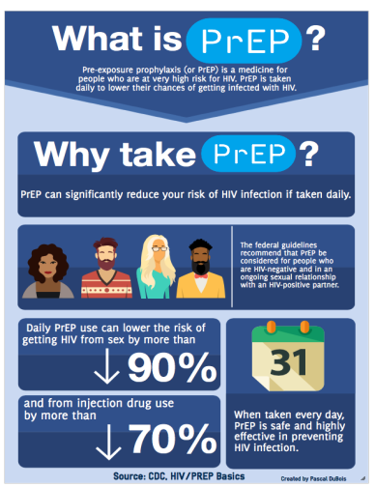
Quiz: Safeguards & Prevention
Which of these methods do not prevent HIV/AIDS?
Condoms
PrEP
Dental Dams
Birth Control
Abstinence
Notes:
Answer: Abstinence

Slide 17
Quiz: Safeguards & Prevention
True or False: Someone can contract HIV by kissing someone who is HIV positive.
How can HIV be transmitted?
Semen
Blood
Pregnancy from mother to child
Vaginal fluids
Breast milk
Sharing of unsterilized needles
All of the above
Notes:
Answer 1: False
Answer 2: All of the above

Slide 18
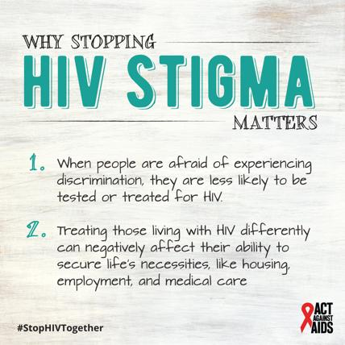
Quiz: HIV Support & Treatment
True or False: Receiving an STD test that screens for HIV is the most accurate way to know if you have HIV or other STDS.
Notes:
Answer: True

Slide 19
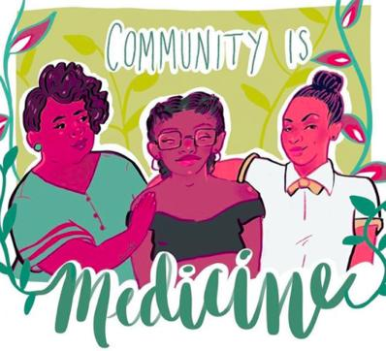
Quiz: HIV Support & Treatment
True or False: People living with HIV/AIDS can live healthy lives and thrive.
Notes:
Answer: True

Slide 20
How many of you knew this info?
How do you think this can benefit other young people and their families?
What is the current state of sex ed in your school?

Slide 21
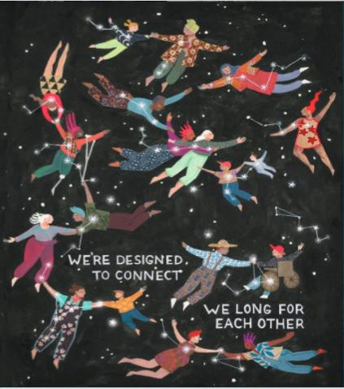
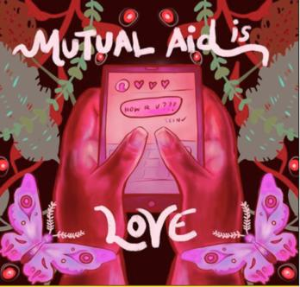
Closing & Announcements
Next meeting date and time
Click here to sign up for weekly GSA Network updates.

Slide 22
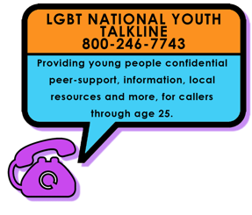
Get Immediate Support
English + Espanol

Slide 23
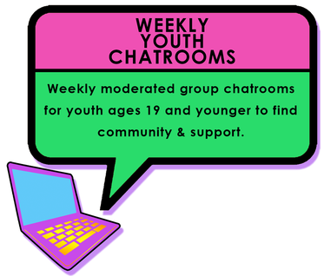
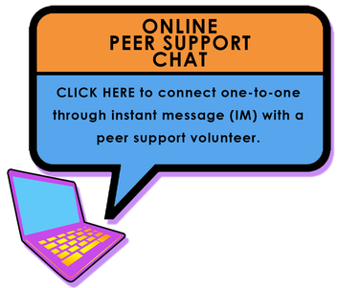
Virtual Opportunities
lgbthotline.org
LGBT teens Tuesdays & Wednesdays 4-6 pm pacific
Trans Teens Thursdays & Fridays 4-7 pm pacific
@qchatspace

Slide 24
THANK YOU!

