Slide 1
Uplifting Asian Pacific Islander Movements
APA Heritage Month
Created by the Youth Organizing Team
Notes:
*This presentation is inspired in part by various curricula developed by APIENC, API Equality-LA, and NQAPIA. Thank you!

Slide 2
Introductions
Type in the chat!
Name
Pronouns
Grade or School
What does solidarity look like to you?
Examples:
Asking my movement sibling how I can show up for them and their community.
Following through with action, no matter how big or small.

Slide 3
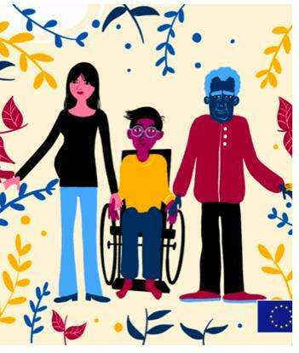
Agenda
Opening
Wellness Tip
Scavenger Hunt
Contributions API of LGBTQ+ Movements
How to show solidarity with API LGBTQ+ communities
Closing
Image: Solidarity

Slide 4
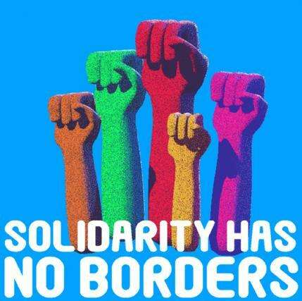
Today’s Goals
Learn more about API movements and API LGBTQ+ activism (just an intro!)
Explore how API movement history connects to today
Find API LGBTQ+ resources
Image: Solidarity Has No Borders

Slide 5
Sample Community Agreements
Be as present as you can.
1) Mute audio
2) Try on video
3) Use the chat box
“Vegas Rule”
What’s said here stays here; what’s learned here leaves here.
“Right to Pass”
Community Garden
→Chat it!
Intent vs. Impact
Use content
warnings.
Understand informed consent.

Slide 6
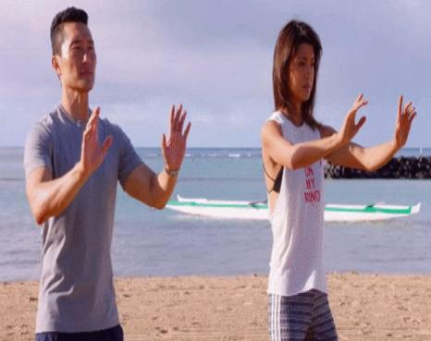
Wellness Tip
Tai Chi is a Chinese martial art practiced for its defense training, health benefits, and meditation.
This is a Tai Chi practice called “Forward Stance” that’s adapted and taught by a Zen Master and
Tai Chi Teacher/ High Priest
Norma Wong.
Image: Tai Chi
For more information about Norma Wong and Forward Stance, check out: https://movetoendviolence.org/resources/6040-stance-forward-stance-transformation/.
Notes:
Facilitator Script: We would like to invite you to stand if possible. If you are unable or do not feel comfortable standing you can adjust as needed and follow along with the breathing instructions at your own capacity. Please unmute your volume so that we can hear each other. If you are unable to, that is okay. Let's get started:
Please stand with your feet shoulder-width apart. Imagine you have a piece of paper under the heel of your feet. This position is the actual forward stance or the 60/40 stance. This helps you find your strongest stance (often a stance that is hard to push you over).
As we are standing here, recognize where you breath is. Is it in your high chest, middle chest, or low stomach? When we are dealing with stress or anxiety our breath will be in our high chest area. We would like to get you to breathe in your low stomach area (near your belly button). When that happens, we can slow our blood flow and become more relaxed and have more focus.
Standing here, let's take three breaths together. Do your best to fill your chest up with air down to your belly button, take 3 breaths without movement.
Now we will add movement. Place your hands with intercrossed fingers near your belly button/stomach. We’ll breathe in raising our hands centered to the sky. Exhale while spreading your arms in a half circle, then close the circle at the center of our chest with your arms crossed.
Reverse these steps and repeat.

Slide 7
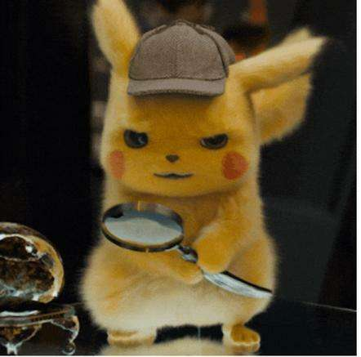
Online Scavenger Hunt
In your teams, you will need to assign:
Someone to keep track of what you're looking for
Someone to take notes of your answers
Someone to use their phone or computer to search for the answers
Image: POKÉMON Detective Pikachu

Slide 8
Online Scavenger Hunt Tasks & Questions
On your mark, get set, go!
Take a team selfie and come up with a team name
The United Farm Workers Movement of the 1960's needed a common way to communicate the end of a day in the field. What was the way they ended their day? What is the phrase they used? What does it mean and where does it come from?
What organizing happened at Camp Tule’ake?
What are the names of the groups who created the Third World Liberation Front?
What is BAGMAL from 1979? What did they seek to do?
What is the meaning of Trikone? What is the group Trikone famous for?
What is the name of the organization that provides a community for queer API women and transgender folks in the San Francisco Bay Area, hosts gatherings for the community, and provides scholarships for queer API youth?
Notes:
Note for facilitator: Determine how much time you’ll give teams to complete the scavenger hunt. Set a timer and periodically share how much time is left.

Slide 9
Answers!
#2: Farmworkers did the the Unity Clap called "Isang Bagsak," which in Tagalog means "one down" or "one fall.” The term comes from the Philippines. Clapping was a common language that all workers could understand.
#3: Camp Tulelake was the last Japanese internment camp to shut down. It also had some of the most active political landscapes of all the internment camps, with many Japanese people organizing to improve conditions in the camp, which had some of the harshest incidents of repression against Japanese internees.

Slide 10
Answers!
#4: A coalition of the Black Students Union, Native American Student Alliance, the Latin American Students Organization, the Phillipine American Collegiate Endeavor (PACE), the Filipino-American Students Organization, and El Renacimiento formed the Third World Liberation Front (TWLF) at San Francisco State University.
#5: Boston Asian Gay Men and Lesbians (BAGMAL), sought to confront racism within the queer movement and develop a sense of empowerment among queer Asians.

Slide 11
Answers!
#6: Trikone, meaning “triangle” in many South Asian languages, was formed in 1986 in the San Francisco Bay Area by queer South Asians. Publishing the “Trikone” newsletter for an international audience regularly, the organization became a core association for queer South Asians in Northern California and a well-known queer rights advocacy group internationally.
#7: Asian Pacific Islander Queer Women and Transgender Community (APIQWTC – pronounced “API-cutesy”) provides a community for queer API women and transgender folks in the San Francisco Bay Area, hosts gatherings for the community, and provides scholarships for queer API youth.

Slide 12
What representations do you usually think of when you hear Asian or Pacific Islander?

Slide 13
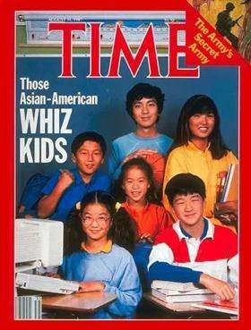
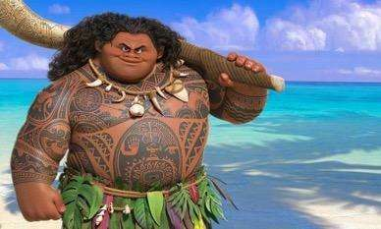
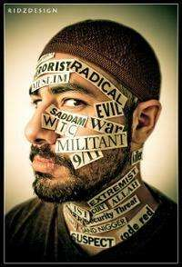
Stereotypes
Images: Whiz Kids, Eat Pray Love, Maui, Islamophobia
Notes:
Note for facilitator: 1. the nerd 2. the exotic, spiritual other 3. physical and strong islander 4. extremist

Slide 14
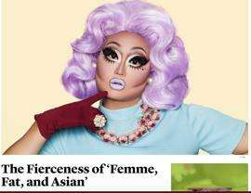
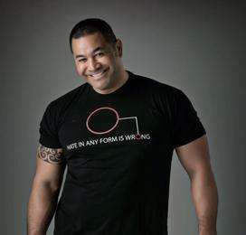
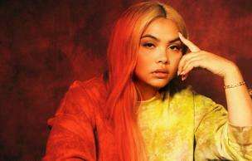
API LGBTQ+ Diversity
Images: Kim Chi h/t API Equality LA, Chella Man, Esera Tuaolo, Janet Mock, Tan France, Hayley Kiyoko

Slide 15
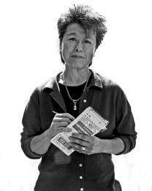
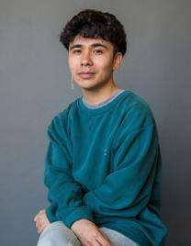
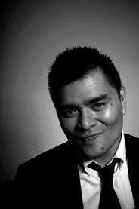
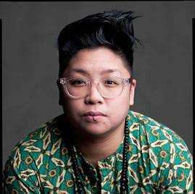
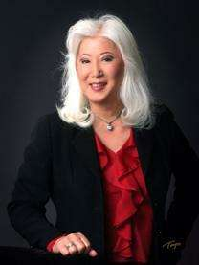
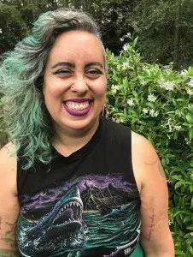
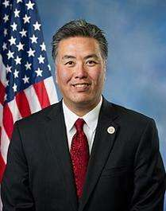
Images: Helen Zia, Ocean Vuong, Jose Antonio Vargas, Kay Ulanday Barrett, Mark Takano, Mia Yamamoto, Amita Swadhin, Leah Lakshmi Piepzna-Samarasinha

Slide 16
Who is “API”?
Asian
Pacific
Islander
Asian American
Asian American Pacific Islander (AAPI)
Native Hawaiian Pacific Islander
(NHPI)
Asian Pacific American
(APA)
Notes:
Facilitator Script: It’s actually a made up umbrella category. Some other variations are listed above.

Slide 17
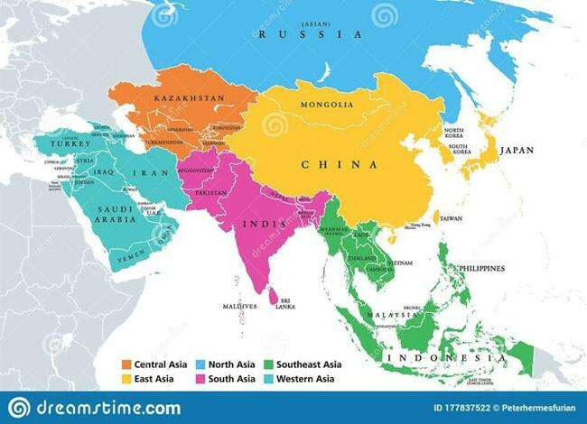
Regions + Nationalities in Asia*
Chinese
Japanese
Korean
Mongolian
Taiwanese
Tibetan
Burmese
Cambodian
East Timorese
Hmong
Indonesian
Laotian
Malaysian
Singaporean
Thai
Vietnamese
Filipino/x**
Afghan
Bangladeshi
Bhutanese
Indian
Maldivian
Nepalese
Pakistani
Sri Lankan
*Non-exhaustive, based on Census ethnic group categories plus some additions. This is a snapshot of the wide range of ethnic groups in Asia within and beyond nation states. **Sometimes Filipinx is separated out from Southeast Asian in the U.S.
Image: Map of Asia

Slide 18
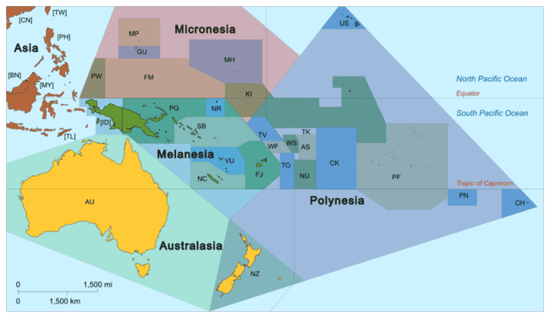
Pacific Islands
Chamorro / Guamanian
Fijian
Marshallese
Native Hawaiian
Palauan
Pohnpeian
Samoan
Tahitian
Tongan
Saipanese
Tokelauan
Yapese
(and more!)
Guam, Northern Mariana Islands, American Samoa are U.S. territories. Hawai’i is a U.S. state that is occupied by the U.S.
Image: https://en.wikipedia.org/wiki/Pacific_Islander
Source: https://www.advancingjustice-la.org/sites/default/files/A_Community_Of_Contrasts_NHPI_CA_2014.pdf

Slide 19
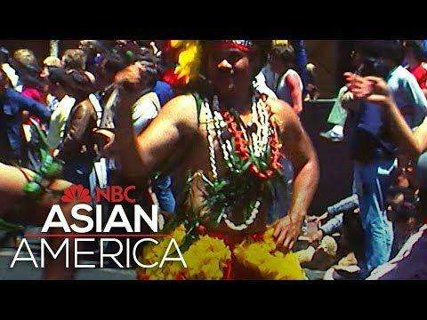
Searching for Queer Asian Pacific America, Part 3 of 5
Source: https://www.youtube.com/watch?v=225E1cQvulw&list=PL6PNhQtSleUedDyH9AHbppGAuAsqnsV5E&index=3

Slide 20
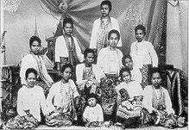
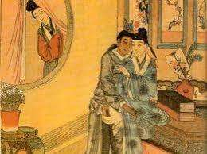
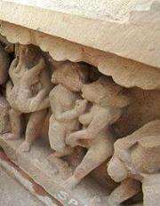
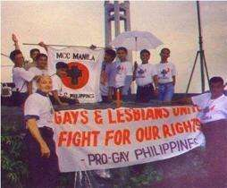
Queer Histories & Non-Western Sexualities
Images: Thailand, Philippines, India, China
Notes:
Facilitator Script: Learning about API trans and queer folks, we can explore gender and sexuality outside of a western gender binary and western LGBTQ+ identities. There are many queer sexualities throughout history. There are also contemporary identities in Asia that are queer but they don’t have to use the same words.

Slide 21
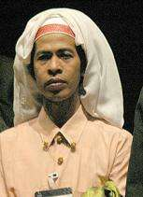
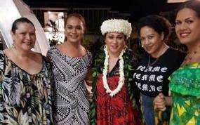
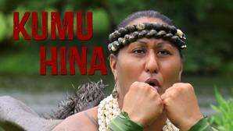
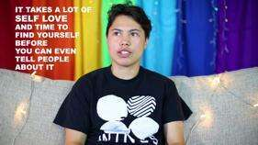
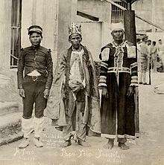
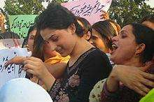
Non-Western Third Genders
Fa’afafine & Fa’atane
(Samoa)
Calalai, Calalbai, and Bissu
(Bugis culture, Indonesia)
Māhū
(Hawai’i, Tahiti)
Hijra
(Pakistan, Bangladesh, India)
Takatāpui
(Māori)
Bakla
(Philippines)
Images: Calalai, Calalbai, Bissu, Fa’afafine & Fa’atane, Hijra, Kumi Hina, Takatapui, Bakla
Notes:
Facilitator Script: There are many different genders in “Asian Pacific Islander” cultures that in English we sometimes call “third genders.”

Slide 22
Nationalism, Imperialism, & Colonialism
Notes:
Facilitator Script: The U.S. has had a long military and government presence, as well as supported wars, in many parts of Asia. Despite all of the diversity within API communities, that’s a common experience. Many are in the U.S. because of this history. Can’t forget that!

Slide 23
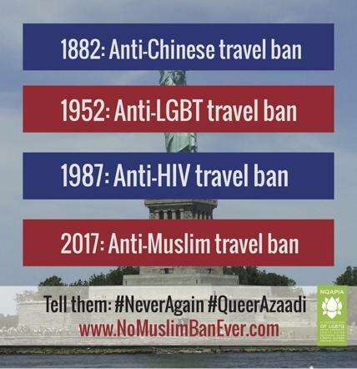
An Old Playbook
1875: Page Act polices immigrants around sexuality
Image: Travel Bans
Notes:
Facilitator Script: There’s also a history of racism against these communities from the moment they migrated here. The earliest waves of Asian migration included Chinese folks. White folks in the US started to get worried, which led to the first restrictive immigration policy and the first laws that restricted people based on ethnicity. Gender and sexuality also played a supporting role in US racism.

Slide 24
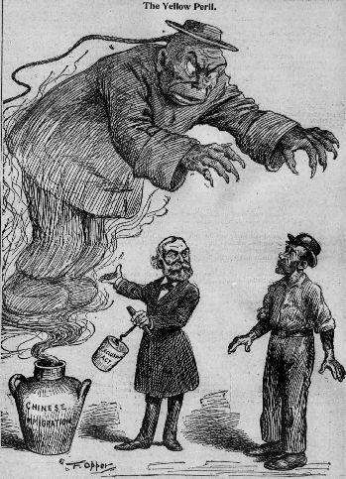
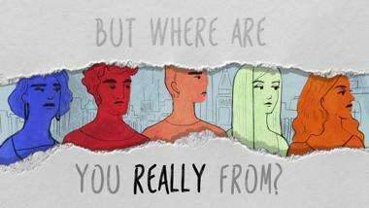
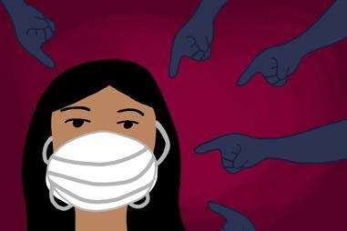
The “Perpetual Foreigner”
Images: Yellow Peril, Where are you really from?, Mask
Notes:
Facilitator Script: The “perpetual foreigner” is an idea that, no matter what, Asians are seen as foreign, other, and not “American.”

Slide 25
COVID-19
Image: Unmasking Yellow Peril
Notes:
Facilitator Script: COVID-19 has resulted in Anti-Asian racism. It’s important to realize that we see white supremacy and structural racism playing out in different ways for different communities of color. It’s important to fight back on all fronts and we’ve seen powerful resistance within many API communities.

Slide 26
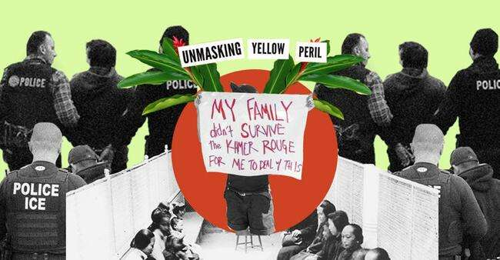
New Pages, Old Playbook
Image: Unmasking Yellow Peril
Notes:
Facilitator Script: Border policing actually started as a way to keep Chinese migrants out of the southern Mexico border. Today we see the expansion of ICE to target many people of color, including Southeast Asian communities. Many people also have biased attitudes that villainize Muslim folks and people perceived as Muslim.

Slide 27
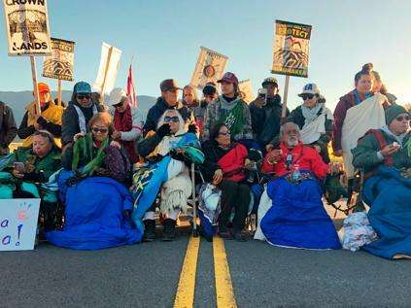
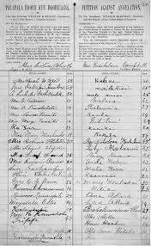
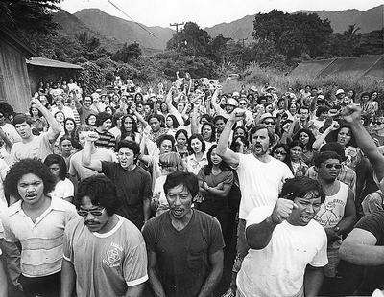
Hawaiian Sovereignty Movement
Anti-Annexation Petition, 1897
Mauna Kea, 2019
Hawaiian Renaissance, 1970s
Images: Petition, Renaissance, Mauna Kea
Notes:
https://www.archives.gov/education/lessons/hawaii-petition
http://the.honoluluadvertiser.com/article/2009/Aug/16/ln/hawaii908160330.html
https://www.insider.com/native-hawaiians-activists-blocking-mauna-kea-photos-2019-8

Slide 28
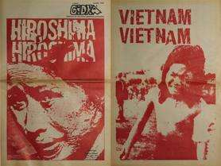
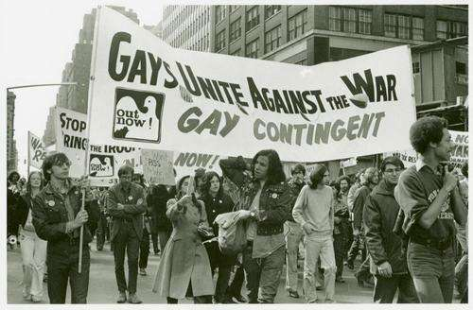
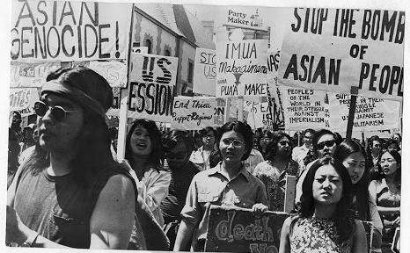
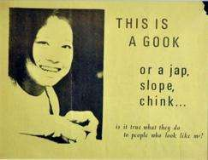
Anti-War Movement
Images: Gidra Newspaper, Gays Unite, Poster, March

Slide 29
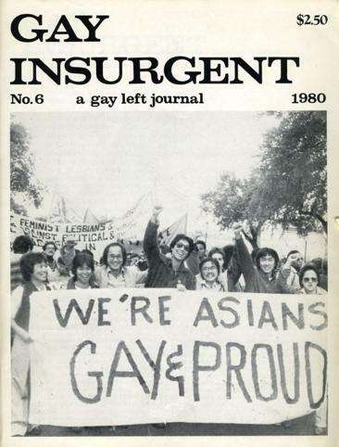
LGBTQ+ Organizing
...For years Asian Americans have organized against our oppression. We protested and were lynched, deported, and put into concentration camps during World War II. We must not forget that the United States of America has bombed, napalmed, and colonized Asian countries for decades...It could rape and murder Vietnamese women, children, and men, then claim that Asians didn’t value human life.
Image: Daniel C. Tsang, Gay Liberation with quote from “Living in Asian America: An Asian American Lesbian Address Before the Washington Monument” in Asian American Sexualities: Dimensions of the Gay and Lesbian Experience
Notes:
Image: Daniel C. Tsang, Gay Liberation
https://books.google.com/books?id=60PXAwAAQBAJ&pg=PA82&lpg=PA82&dq=Living+in+Asian+America;+An+Asian+American+Lesbian%27s+Address+Before+the+Washington+Monument,%22&source=bl&ots=AyeiI-M3m1&sig=ACfU3U3_51Fdx98ggrz0hTHrVCV06Z5QFQ&hl=en&sa=X&ved=2ahUKEwi_2o2vxrLpAhWpIDQIHbW_CREQ6AEwAHoECAoQAQ#v=onepage&q=Living%20in%20Asian%20America%3B%20An%20Asian%20American%20Lesbian's%20Address%20Before%20the%20Washington%20Monument%2C%22&f=false

Slide 30
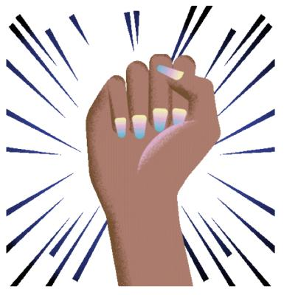
Fighting Anti-Asian Racism Today
1. Contact your local human relations commission or civil rights organization. (Stop AAPI Hate Reporting Center)
2. Urge your local elected officials to pass resolutions and policies that protect your community from violence.
3. Find a organization that is fighting for your interest rights. (Asian Americans Advancing Justice)
4. Volunteer for an organization or campaign that fights anti-Asian racism.

Slide 31
TQAPI Resources
Community
NQAPIA and LGBTQ AAPI Local Organizations
UTOPIA chapters
DesiQ conference
KQTcon
Storytelling Projects
Dragon Fruit Project
Q&A Space
Visibility Project
Network on Religion and Justice
A Day in the Queer Life of Asian Pacific America
Coming Out / Support
Family is Still Family Multilingual PSAs
DeQH
PFLAG API Parents Network (in development)
Desi Rainbow Parents and Allies
Korean American Rainbow Parents
Muslim Alliance for Sexual and Gender Diversity (MASGD)
Network on Religion and Justice

Slide 32
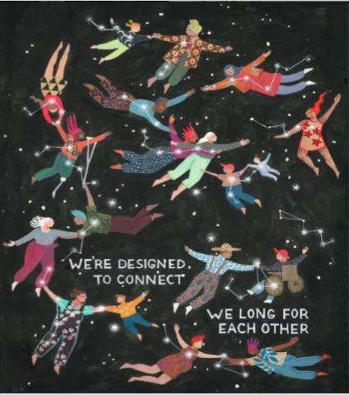
Closing & Announcements
Next meeting date and time
For LGBTQ+ stories, read Youth Voices
Click here to sign up for weekly GSA Network updates.

Slide 33
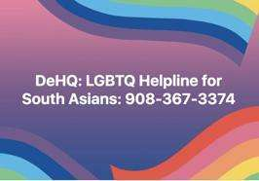
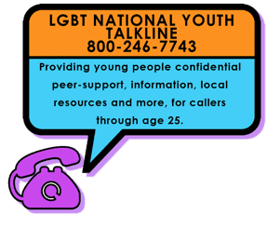
Get Immediate Support
English + Espanol

Slide 34
THANK YOU!

